Slide 1
Online Banking
ICIN BANK

Slide 2
TEAM MEMBERS
Sharyu
Sushma
Varalakshmi
Anusha
Vasavi
Hari
Sandeep
Preethi
Hema
Farha

Slide 3
Introduction
Online banking offers customers almost every service traditionally available through a local branch including deposits, transfers, and online bill payments. Virtually every banking institution has some form of online banking, available both on desktop versions and through mobile apps.

Slide 4
Background Of Project
ICIN is one of the top banking firms that accepts deposits from the public for the purpose of lending loans to the public. It also invests an amount in securities. Recently, the business analysts noticed a drop in the number of customers of the bank. They found out that online banking systems of banks like AXIS and American Express are gaining more profits by eliminating middlemen from the equation. As a result, the team decided to hire a Full Stack developer who can develop an online banking web application with a rich and user-friendly interface. You are hired as one of the Full Stack Java developers and have been asked to develop the web application. The management team has provided you with the requirements and their business model so that you can easily arrange different components of the application.

Slide 5
Procedure of Online Banking
Online banking investigates the entry threshold providing a new transaction service channel for the use of normal users, Organizations and Academicians. Customer must have a valid user id and password to login to the system. If a wrong password is given in succession, that account will be locked and the customer will not be able to use it.

Slide 6
Procedure of Online Banking
After the valid user logs in he is shown the list of accounts he has with the bank. On selecting the desired account he is taken to a page which shows the present balance in that particular account number. User can request for the details of the last ‘n’ numb.er of transactions that he has performed

Slide 7
Scope and System Overview
Scope:
Customers can perform financial transactions like transfer funds online, pay bills, apply for loans and open a savings account among various other debit card transactions.
System Overview :
The “Online Banking” should support basic functionalities for all below listed users.
User
Admin

Slide 8
TECHNOLOGIES USED
OPERATING SYSTEM : Windows 10
FRONT END : Html, CSS, Type script(Angular)
SERVER SIDE SCRIPT : Apache tomcat 8
DATABASE : MySQL
TESTING : J Unit testing
BACKEND : Spring Boot

Slide 9
ADMIN MODULE
Only Admin can Delete Records, can approve Loan Request, Chequebook Request and Block User.
1. Admin login Page
2.Loan approval Page
3. Loan Approval and rejection list Page
4. Transaction Report
5. ChequeBook Request Approval
6. Fund Transfer.

Slide 10
USER MODULE
Each User must have a valid user id and password must be running for the system to function users must login in to system to access any record.
User Registration and Login Page
Profile
Primary and Saving Account page

Slide 11
User Module
4. Account statement
5. Withdraw and Deposit page
6. Loan Page
7. Fund Transaction Page
8. Add Recipient.

Slide 12
Assumptions
Each user must have a valid user id and password
Server must be running for the system to function
Users must log in to the system to access any record.
Only the Administrator can delete records.
Only admin can approve loanrequest, checkbook request, block the user .

Slide 13
Sequence Diagram For Online Banking

Slide 14
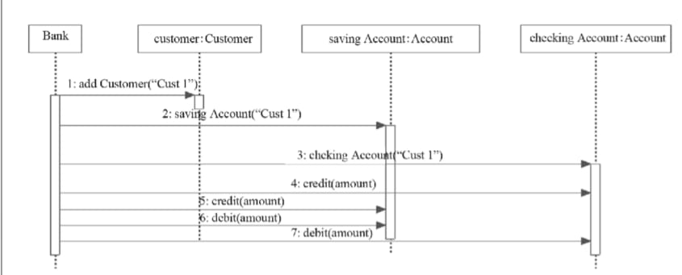

Slide 15
UML Class Diagram and Usecase Diagram

Slide 16
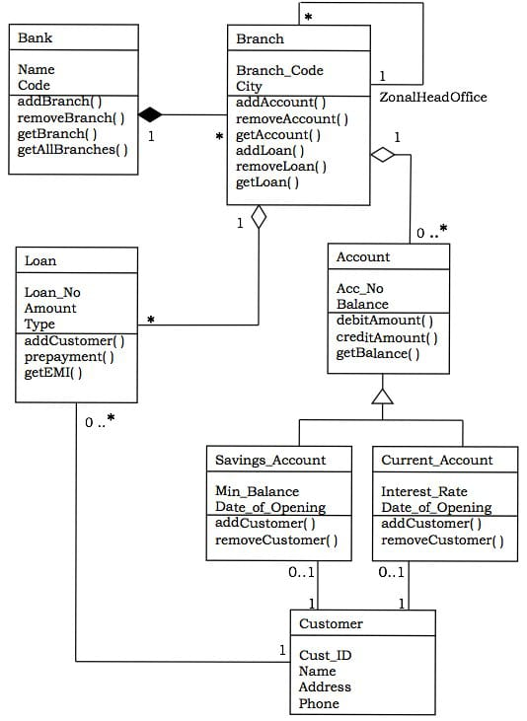
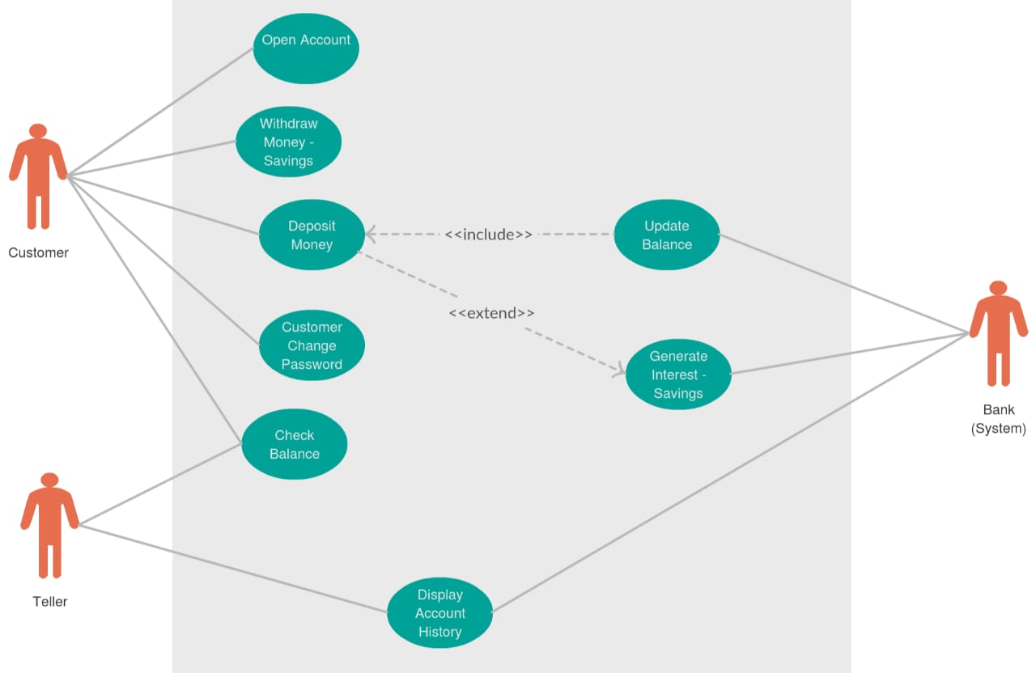

Slide 17
ER Diagram

Slide 18
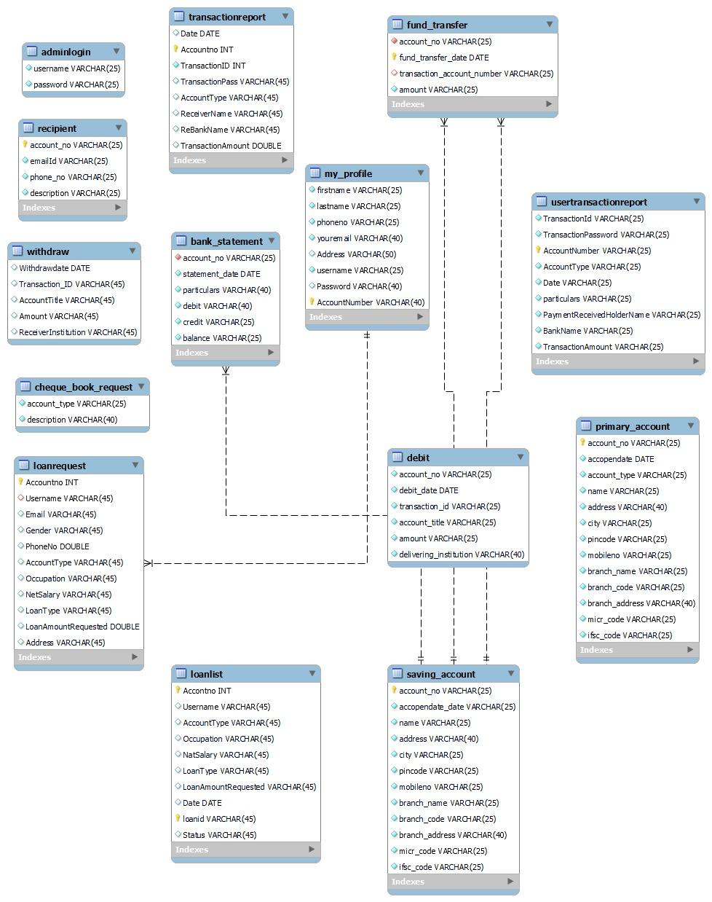

Slide 19
Unit Testing
Verify that for new users based on the user id of the user, their records are added in the database.
Verify that for existing users based on the s.no. of the user, their records are added in the database.

Slide 20
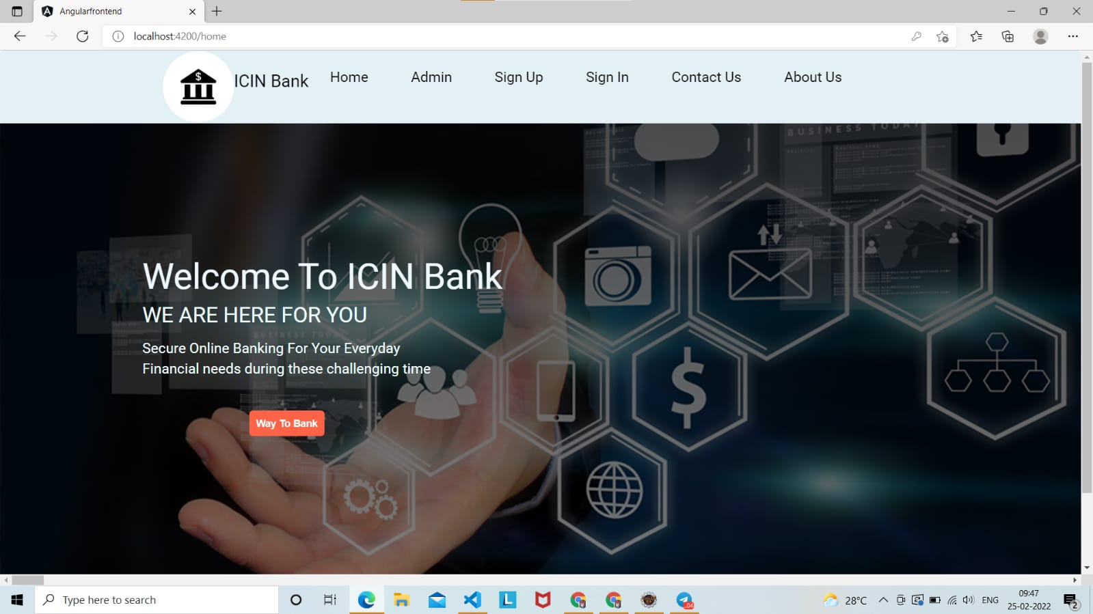
OUTPUT Welcome Page

Slide 21
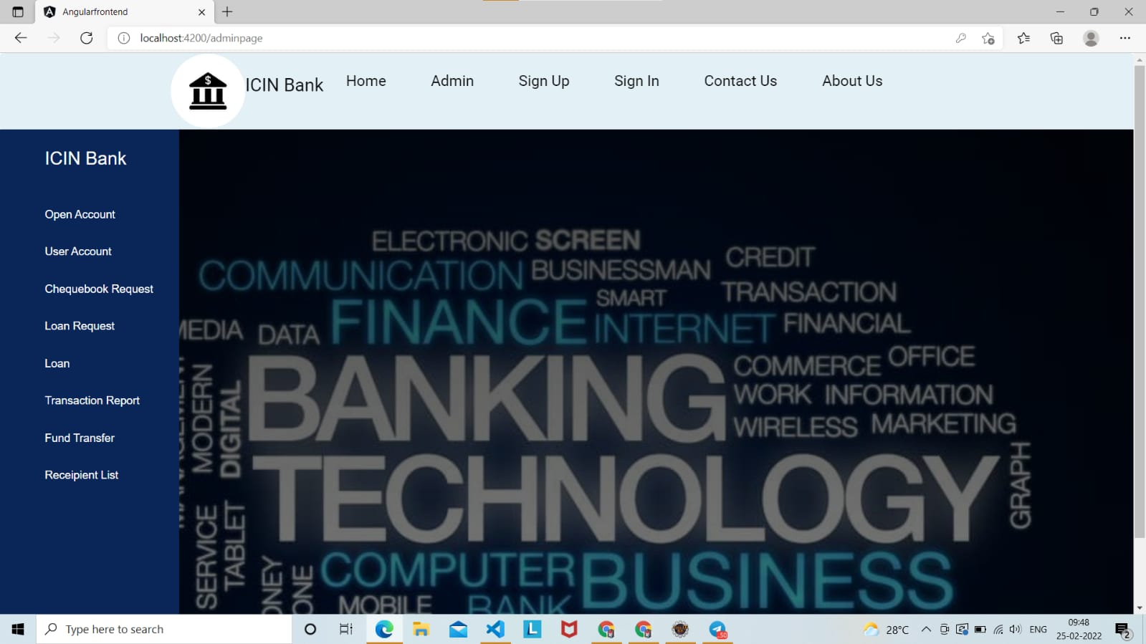
Admin Page

Slide 22
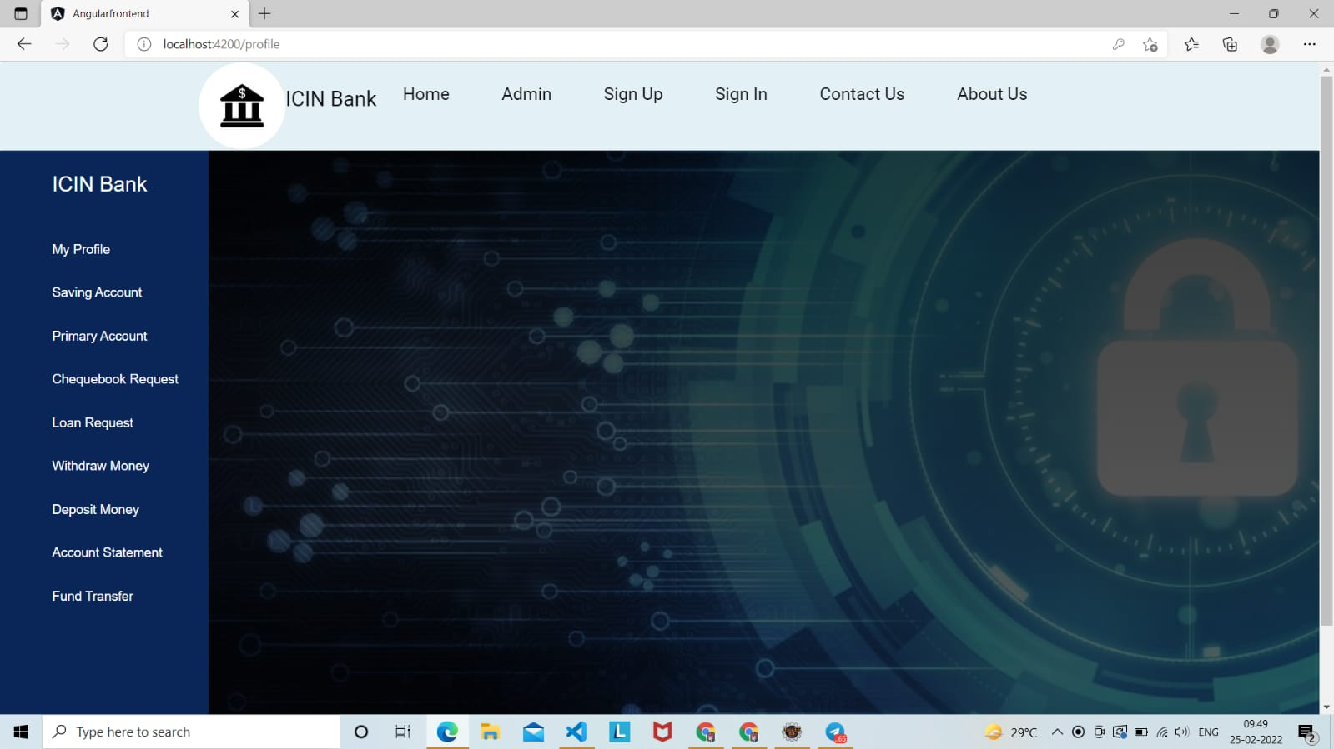
User Page

Slide 23
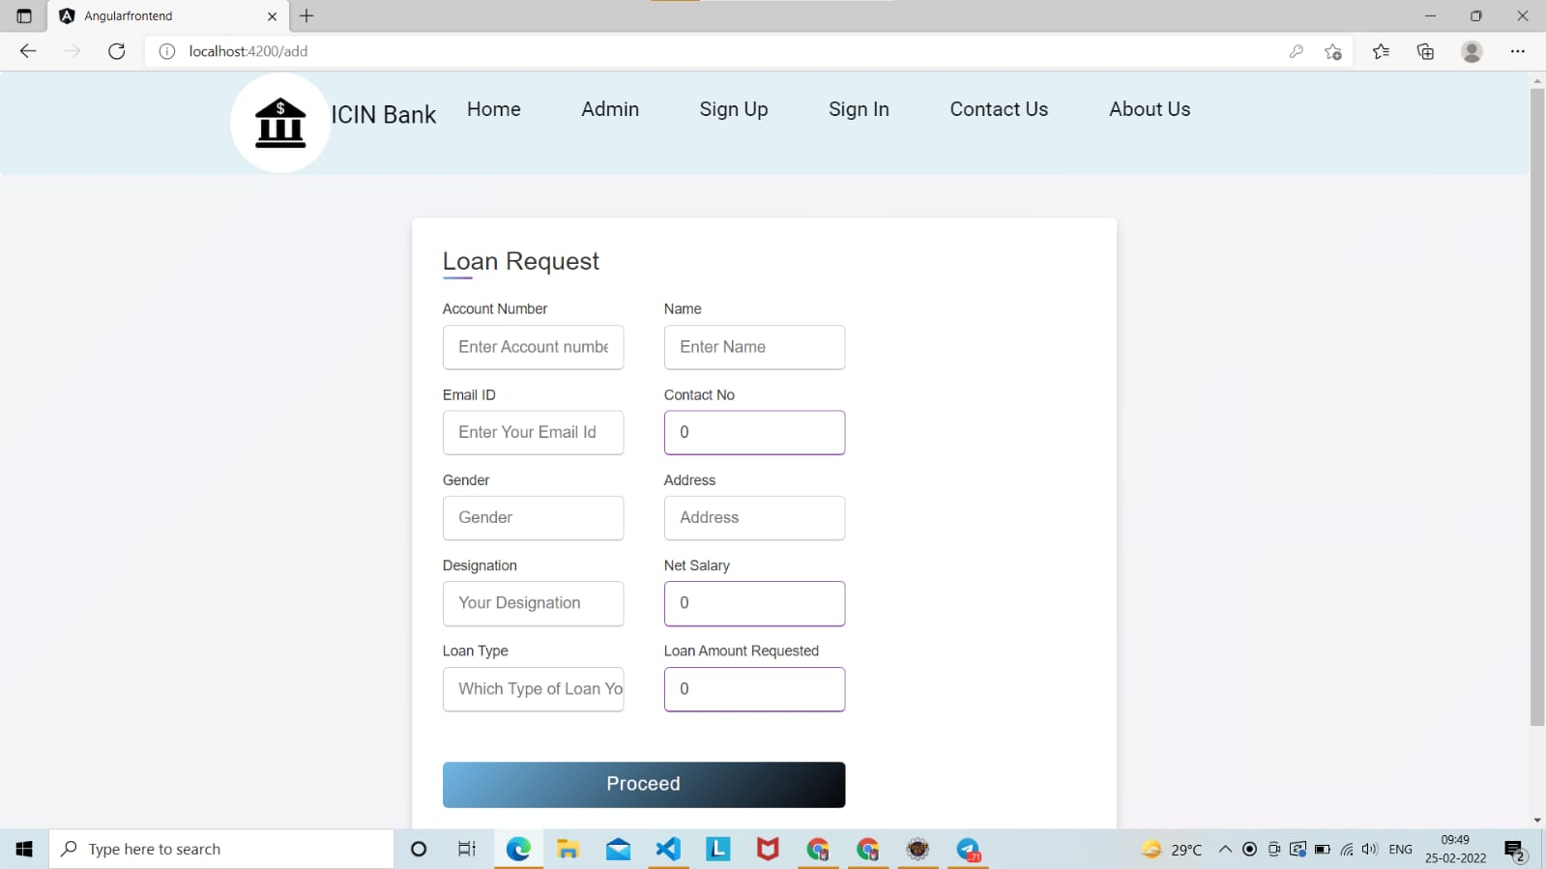
Loan Request

Slide 24
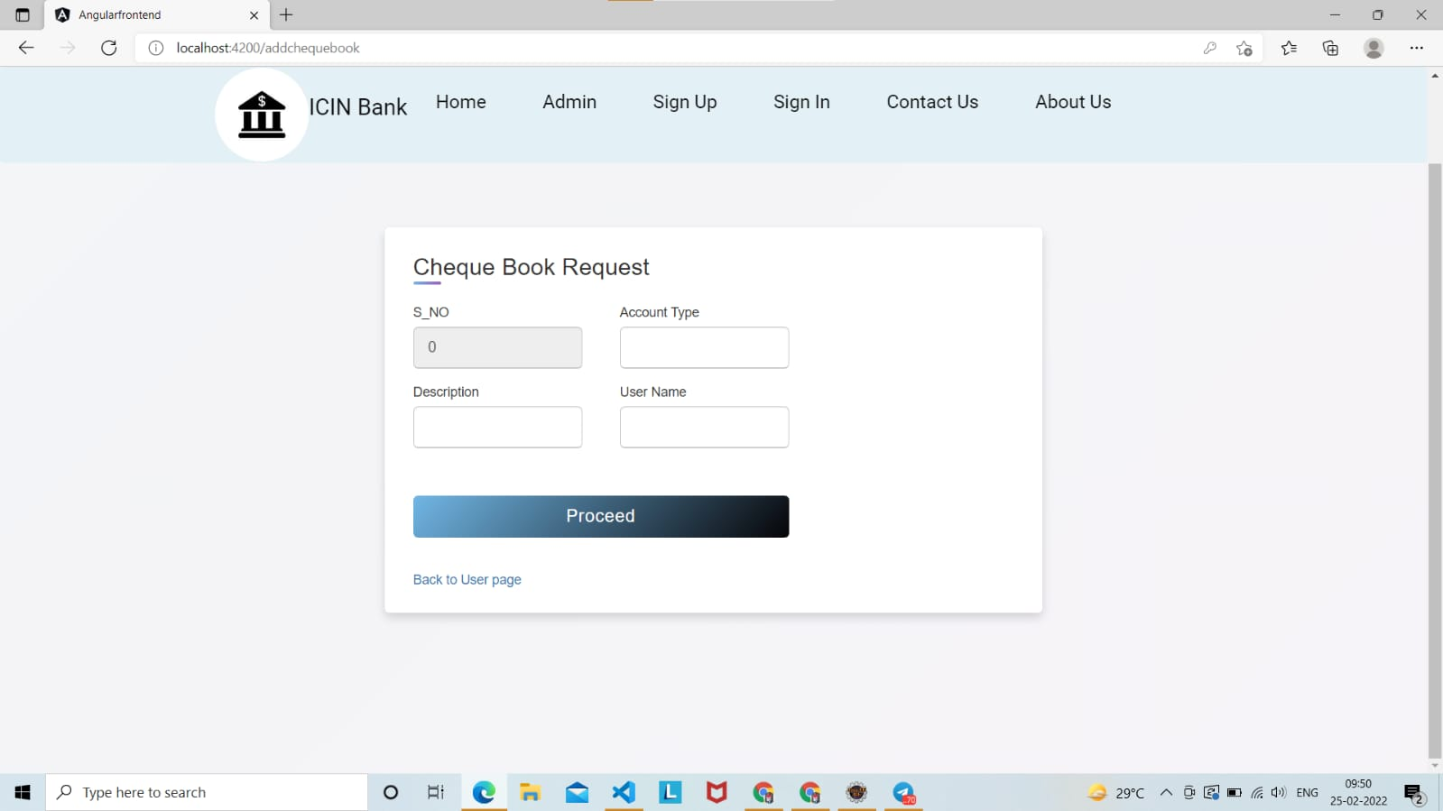
Cheque Book Request

Slide 25
Features
The key features are as follows :
Balance and transaction history search
E statements and statement preferences
Order new statements
Transfers

Slide 26
ADVANTAGES
Easy Fund Transaction between accounts.
Secure Banking.
Access 24/7.
Better Services.
Transfer Money.

Slide 27
Conclusion
The strategy of bank is to provide value added services and products to the consumers, utilizing the internet extensively. The main aim of E-banking or online banking is to make transactions through online processes and provide customers with more benefits. Providing internet banking is increasingly becoming a “need to have” than “nice to have” services.

Slide 28


